Slide 1
A* Algorithm Animations

Slide 2
2
3
t
1
2.23
6
7
10
5
8
9
2
1
4
s

Slide 3
3
3.0
3
t
2.23
1
1.14
1
6
7
10
1.0
2.5
1
1
1
2.82
5
8
9
2.0
1
2
2.23
3.9
0.5
1
1
4.24
1
4
3.6
1
s

Slide 4
Suboptimal Path
Because we stopped early and used a heuristic we can’t guarantee we have found the optimal (best) shortest path
Instead it is a good path we found quickly!
See the next two slides…

Slide 5
3
1
1
Cost of Path = 9
2.5
1
1
1
1
0.5
1
1
1

Slide 6
3
1
1
Cost of Path = 7
2.5
1
1
1
Hence a better choice in this case would have been the manhatten (taxicab) distance
OR use Dijkstra if optimal required!
1
0.5
1
1
1

Slide 7
3
3.0
3
t
2.23
1
1.14
1
6
7
10
1.0
2.5
1
1
1
2.82
5
8
9
2.0
1
2
2.23
3.9
0.5
1
1
4.24
1
4
3.6
1
s

Slide 8
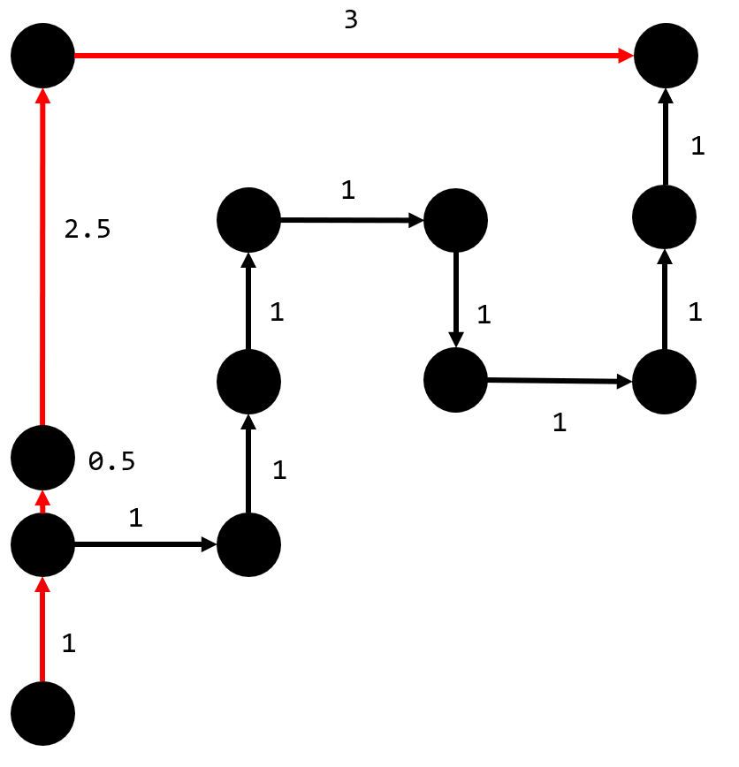
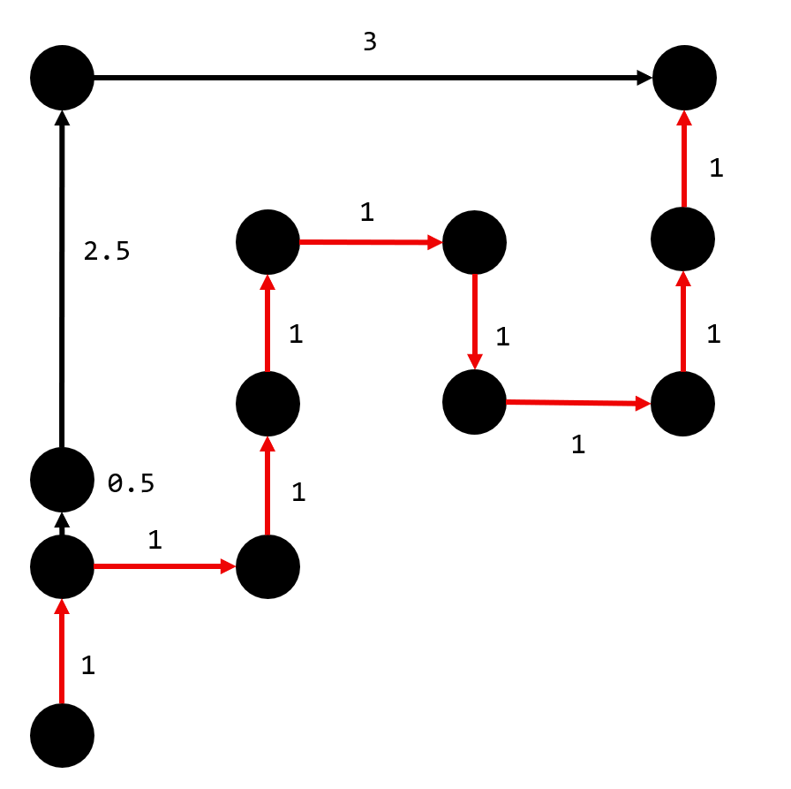
Manhattan
Euclidean
Cost of Path = 7
Cost of Path = 9

